Slide 1
PROPOSAL WRITING
Shishir Subba, PhD/

Slide 2
The title contain:
RESEARCH
PROPOSAL
Shishir Subba, PhD/

Slide 3

What is research?
An activity of answering the question or solving the problem by using systematic procedure.
An activity that usually leads to discovery of new knowledge or new understanding related to topic involved.
An organized way of finding answer.
Shishir Subba, PhD/

Slide 4
Aim of the research
To discover the answer of a question by using scientific method
Find the hidden truth, truth or fact not yet discovered
Shishir Subba, PhD/

Slide 5
OBJECTIVES OF RESEARCH
To explore or formulate research study (Exploratory study)
To gain familiarity with a phenomenon
To achieve new insight of a phenomenon
To describe the situation/individual/group (Descriptive study)
  Portray accurately the characteristics of a person
  Characteristics of situation or group
  A fact finding study
To determine the frequency of occurrence of a condition associated with something else (Explanatory/correlational study)
  Diagnostic research (PTSD and distress or chronic stress)
  Prediction /probability of occurrence e.g., domestic violence & suicide
Hypothesis Testing study
Shishir Subba, PhD/

Slide 6
QUALITIES OF A GOOD RESEARCHER
1. Research-oriented
2. Efficient
3. Scientific
4. Effective
5. Active
6. Resourceful
7. Creative
8. Honest
9. Economical
Shishir Subba, PhD/

Slide 7
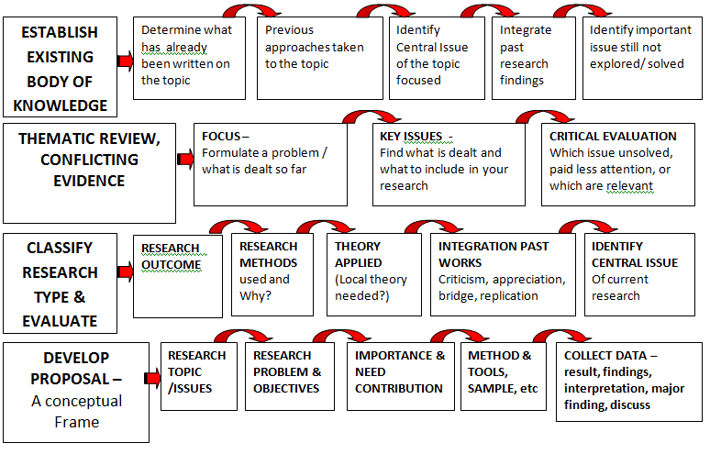
DOING RESEARCH – YOUR ACTIVITIES
Shishir Subba, PhD/

Slide 8
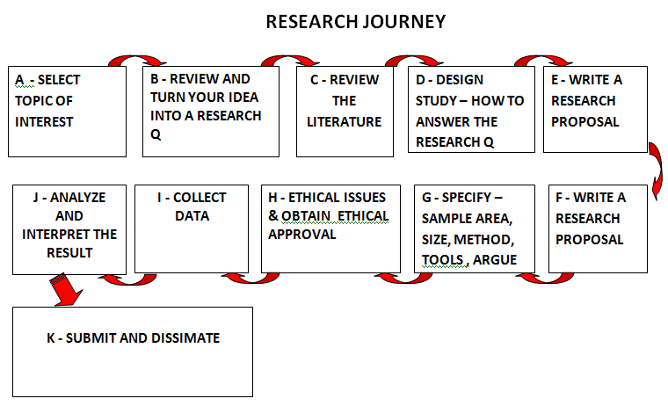
Shishir Subba, PhD/

Slide 9

Shishir Subba, PhD/

Slide 10
Steps in reaching to research goal
GOAL
6 Method
5 Conceptual frame
4 Review literature
3 Objectives
2 Research Q.
1 Problem
Literature Review

Slide 11
PROPOSAL WRITING
Shishir Subba, PhD/

Slide 12
KEEP IN MIND WHEN WRITING A PROPOSAL
Need of research proposal
Importance of proposal
Importance of
  Issues and Background
  Need and rationale
  Problem stated
  Objectives stated
  Conceptual Frame
Method/s and Review of literature
Research process & organization
Target Group
Shishir Subba, PhD/

Slide 13
A plan for solving a problem
An overall scheme, structure and strategy
Demonstrate your understanding of research and communicate his/her ‘research thinking’ to others.
Systematic description & explanation of need, importance, problem, objectives, method, etc.
It gives an idea of WHAT, HOW, WHY you are undertaking the study to the evaluator.
It gives an idea about how you are contributing knowledge or fact in the given topic
Shishir Subba, PhD/
Notes:
Shishir Subba, PhD/Research Methods

Slide 14
Research proposal is a way of telling people what you plan to do, why you want to do it, and how you are going to do it.
With Proposal you need to convince that …
You have an exciting research idea about an issue
You have good grasp of the relevant literature
You have appropriate methodologies
You can write clearly and appropriately
Shishir Subba, PhD/
Notes:
Shishir Subba, PhD/Research Methods

Slide 15
PROPOSAL SHOULD TELL…
What others will learn from your result that they do not know?
What you are planning to accomplish?
Why you want to do it?
How you are going to do it?
Why is it worth knowing/doing?
How will the readers/reviewers know that the conclusions are valid?
Shishir Subba, PhD/

Slide 16
What to Remember while writing a proposal
  That, a proposal is an operational plan for answering research questions.
  That, it should contain major information about the study.
  That it should convey that there is a need for the research; it is significant and important.
  That the research is contributing something original to the discipline or adding new knowledge (explanation).
  To ensures and reassures the methods used are appropriate , accurate, and valid.
Shishir Subba, PhD/

Slide 17
Important Rules
Avoid jargon
Avoid trendy words
Avoid abbreviations
Do not try to sound "intellectual"
Avoid redundant phrases
Avoid overused phrases
Shishir Subba, PhD/

Slide 18
Common Mistakes in Proposal Writing
Failure to…
Provide proper context to frame the research question.
Delimit the boundary of the research.
Cite landmark studies.
Accurately present the theoretical and empirical contributions by other researchers.
Stay focused on the research question…persuasive argument
Not enough detail on major issues.
Too many citation lapses and incorrect references.
Too long or too short.
Failing to follow the APA style.
Shishir Subba, PhD/

Slide 19
Key to Good Proposal Writing
Shishir Subba, PhD/
Notes:
Shishir Subba, PhD/Research Methods

Slide 20
Overall Quality of the Study
Good research question
Appropriate research design
Appropriate, feasible methods
Organization
Shishir Subba, PhD/

Slide 21
Quality of the Proposal
Informative title
Self-sufficient and convincing abstract
Clear research questions
Scholarly and pertinent background and rationale
Relevant previous work
Appropriate population and sample
Appropriate measurement and intervention methods
Adequate sample size
Sound analysis plan
Ethical issues well addressed
Shishir Subba, PhD/

Slide 22
Quality of the Presentation
Clear, concise, well-organized
Helpful table of contents and subheadings
Good schematic diagrams and tables
Neat and free of errors
Shishir Subba, PhD/

Slide 23
GENERAL FORMAT
FOR
PROPOSAL WRITING
Shishir Subba, PhD/

Slide 24
General Format for Proposal Writing
Title of the study
Introduction/background
Statement of the problem (Research Questions, if any)
Hypothesis (if any)
General/Specific objectives
Rationale of the study
Limitations of the study
Review of the Literature
Conceptual/theoretical background
Research methodology
Sample area, Sample size, Sampling procedure, Method and specific tools, Data collection procedures and analysis of the data, Ethical issue for the research
Result and Discussion
Organization of the study (Content analysis of chapters)
Appendices
Selected Bibliography/Reference
Shishir Subba, PhD/

